Slide 1
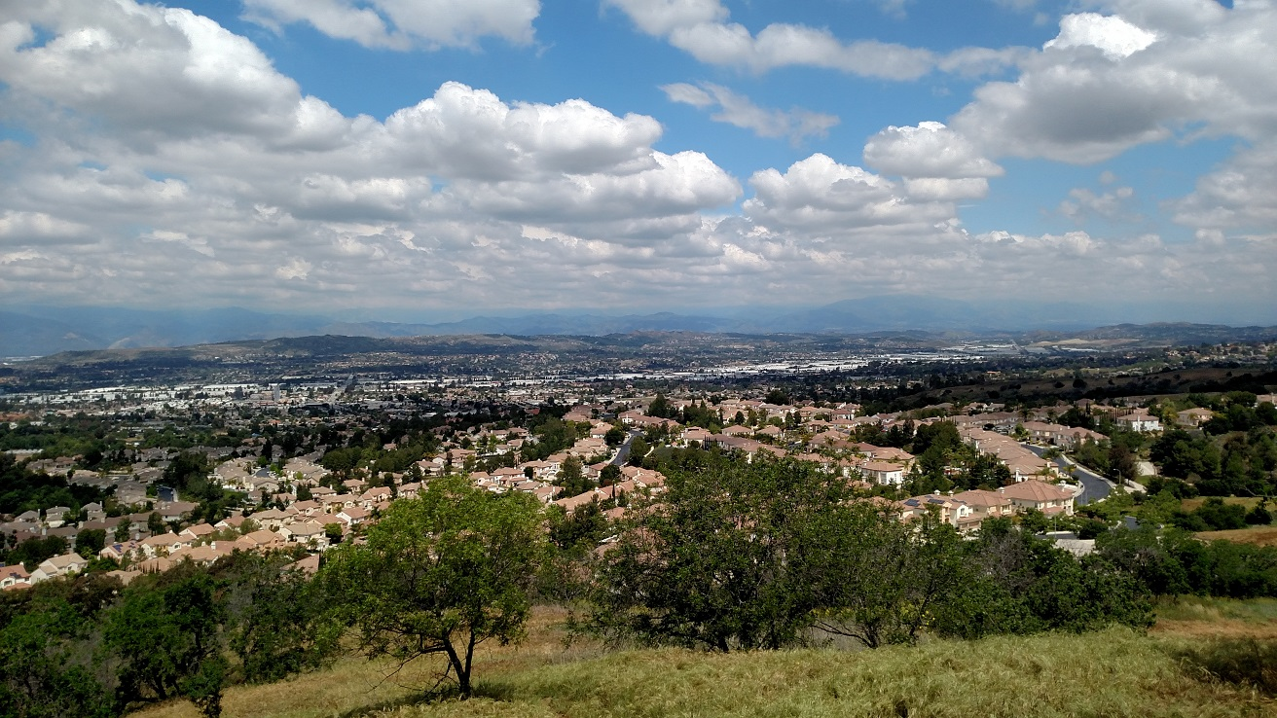
Parts of
Rowland Heights are at high risk for wildfires.

Slide 2
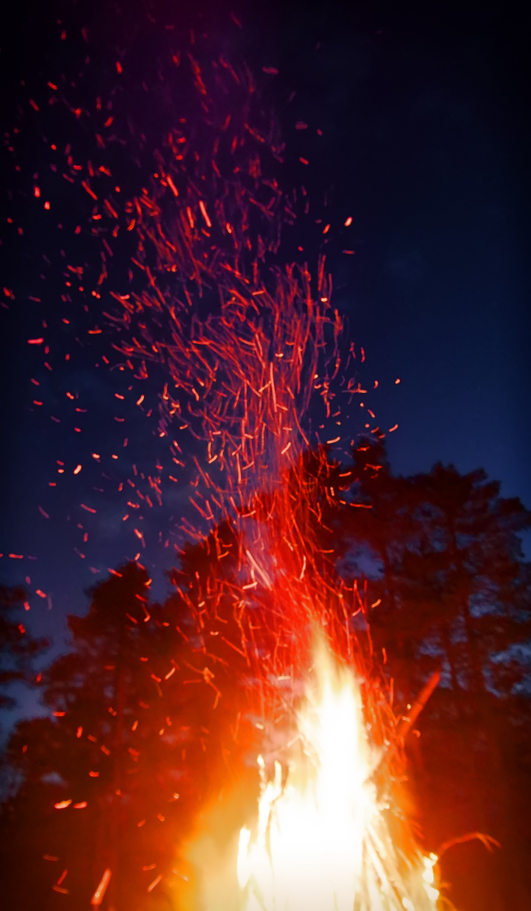
Flying embers are the primary driver for rapid spread of wildfires into communities. - FEMA
Embers can travel up to a mile, and land on the roof, deck, or porch.
Embers accumulate and can easily ignite plants, dry leaves or lawn furniture.
Embers can also enter the home or attic through a vent or open window and ignite the contents of the house.
Notes:
Flames aren't the only way wildfires spread. Embers, also known as firebrands, can travel miles through the wind and ignite fires in and around structures.

Slide 3
Defensible Space
A buffer between a structure and the nearby and surrounding vegetation and items that could catch fire.
slows the spread of wildfire
improves the safety of firefighters defending a home
Three Zones
Zone 1
Zone 2
Zone 3
0-30 ft.
30-100 ft.
100 ft.
Notes:
Defensible space is the first line of defense for your home against wildfire. This space is intended to:
Minimize the pathways of wildfire to burn directly to the home.
Reduce radiant heat exposures to the home and structures.
Reduce the potential for embers to ignite vegetation adjacent to the home.
Provide a safe place for fire personnel to defend the home and allow for safe routes for evacuation.

Slide 4
Defensible Space
What to Do:
Remove vines/climbing plants.
Mow grass to a max. height of 3”.
Remove leaf litter, dead plant material, and around the property.
Trim trees to keep branches a min. of 10’ from other trees.
Notes:
the roofs, rain gutters, decks and porches

Slide 5
Home Hardening
Make your house more fire resistant.
ember-resistant vents
multi-pane tempered glass windows
well-sealed garage doors
fire-resistant siding (stucco, brick, or metal)
First five feet of attached fences should be made of metal or other non-combustible material.
Notes:
the roofs, rain gutters, decks and porches

Slide 6
Create a Plan
Each wildfire action plan will be unique to each family, but all plans should cover:
designated emergency meeting location
at least two escape routes from the home and community
Practice your plan regularly, post it a safe and accessible place, and make updates as needed.
Notes:
Have a safe meeting place outside that is safely away from the disaster area.
Make sure everyone knows how to call for help,
Practice drills during the day and at night.
Learn two ways out of every room. If one of the exits is a window on the second floor, do you have a ladder

Slide 7
Assemble a Kit
Have 72-hours worth of items for each family member, tailored to their needs.
clothing and footwear
chargers and batteries
prescriptions and eyeglasses
first-aid kit and hygiene products
cash and credit cards
pet food
important documents (vehicle insurance and pink slip, tax documents, birth and marriage certificates, and passports)

Slide 8
Communication Plan
Create and post your plan where it can be found by everyone in your household, and store a copy in your emergency kit.
If we need to evacuate, we will we meet at:
Our two evacuation routes are:
During a disaster, phone lines may be overwhelmed – text, don’t call.

Slide 9
Prepare to Evacuate
What to Do Indoors:
Shut indoor windows and doors but leave them unlocked.
Remove combustible window shades and curtains.
Move furniture to the center of the room, away from windows.
Leave indoor and outdoor lights on.
Shut off HVAC and ceiling fans.
Locate pets and keep them nearby.
Notes:
It is important that you are prepared before wildfire strikes. In an emergency it is easy to become confused or panicked. If you know receive an evacuation warning, it means there’s impending danger to your life or property. If a warning is given assume an evacuation order will follow. Start gathering important items for your family and pets. Any individuals who need extra time to evacuate, or anyone with large animals, should pack-up and leave when a warning is issued.

Slide 10
Prepare to Evacuate
What to Do Outdoors:
Load up your vehicle and back it into driveway.
Bring in flammable items or place them in pool.
Connect garden hoses and attach nozzles set on “spray” setting.
Place ladder(s) at the corner(s) of structures for firefighters.
Seal vents with pre-cut plywood, metal covers, or duct tape.
Open fence and/or side gates.
Turn on exterior lights.
Fill buckets with water and place in plain sight.

Slide 11
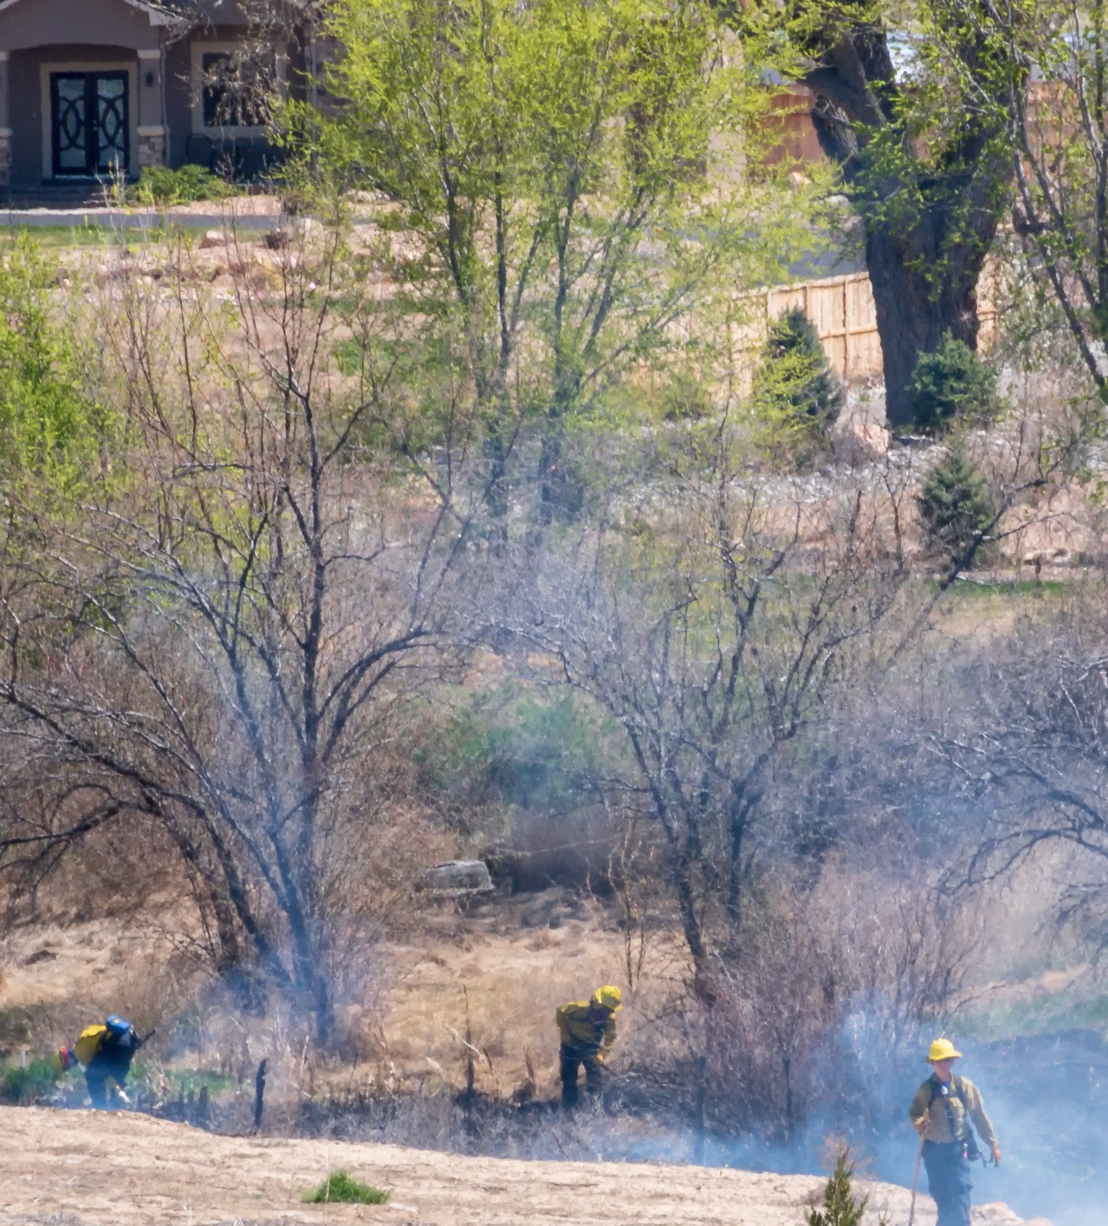
Returning Home After a Wildfire
Do not return home until emergency authorities say it is safe.
When you return home:
Be alert for downed power lines and other hazards.
Check propane tanks, regulators, and lines before turning gas on.
Check property for hidden embers or smoldering fires.

Slide 12
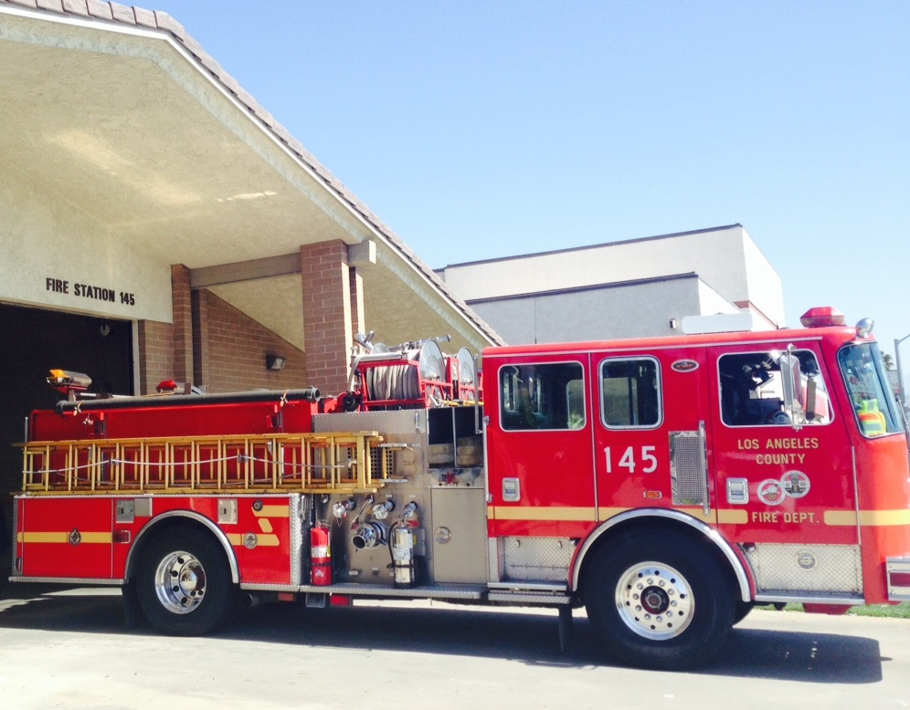
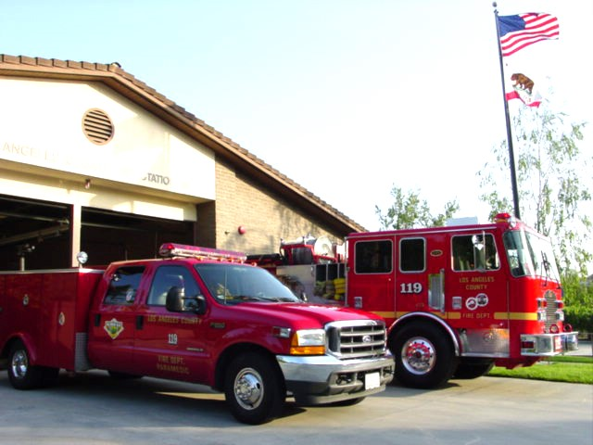
Rowland Heights
Fire Station 145
1525 South Nogales Avenue
Rowland Heights
(626) 854-3486
Fire Station 119
20480 East Pathfinder Road
Walnut
(909) 598-4290
Serving a portion of Rowland Heights

Slide 13
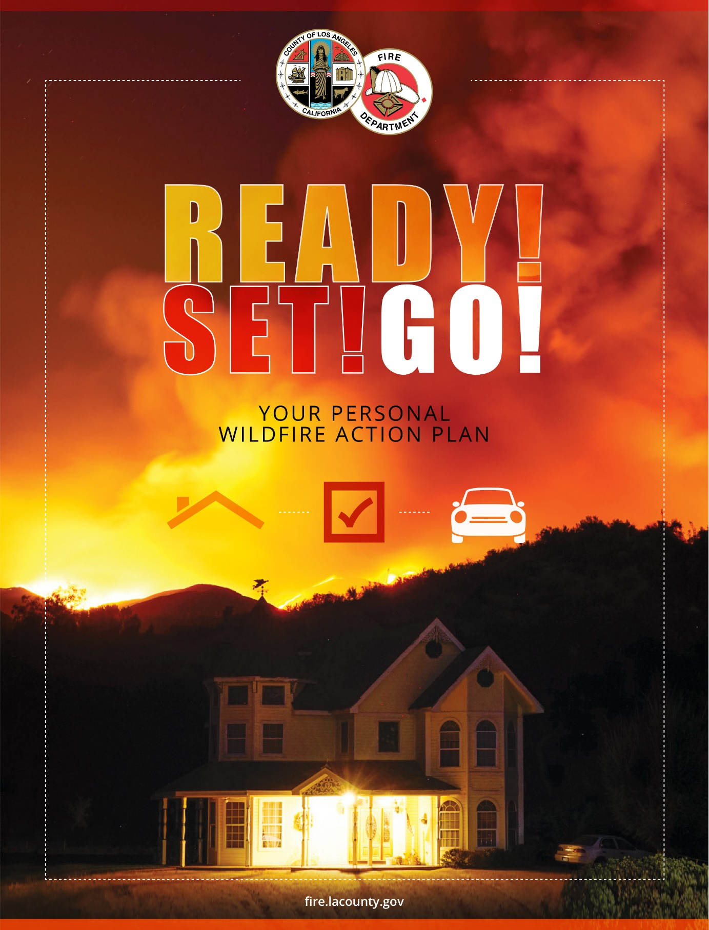
Use the
Ready! Set! Go! Guide to prepare well in advance of a wildfire.
Visit
fire.lacounty.gov

